Slide 1
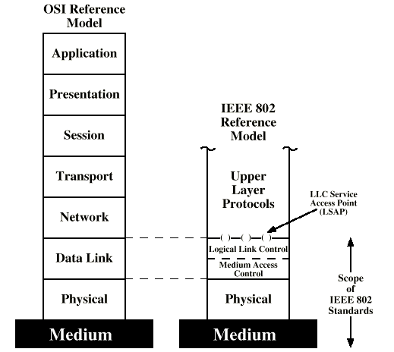
IEEE 802 v OSI

Slide 2
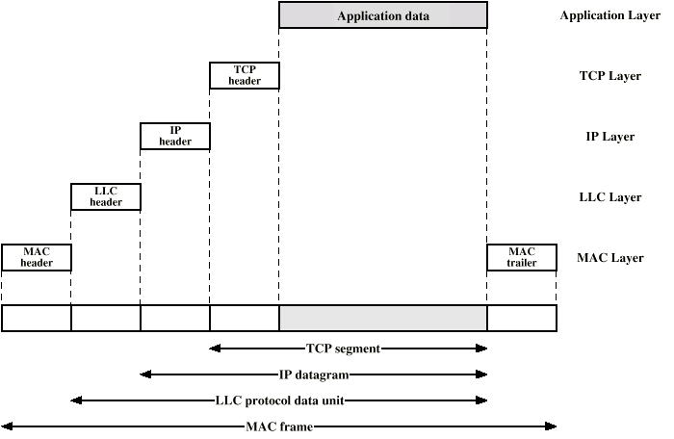
LAN Protocols in Context

